Slide 1
Style and Tone of Business Messages and Documents

Slide 2
Objectives
Rendering a professional tone in business messages
Developing a technical style of writing messages
Delivering oral presentations effectively and forcefully
Employing the subtle nuances of delivery in presenting ideas fluently

Slide 3
Go through the following sentences
Executing vehicular relocation
Optimizing sartorial selection
Facilitating hydration replenishment
Engaging in gastronomical refueling.

Slide 4
Go through the following sentences
Executing vehicular relocation (Moving a car)
Optimizing sartorial selection (Choosing what to wear)
Facilitating hydration replenishment (Drinking water)
Engaging in gastronomical refueling (Eating a snack)

Slide 5
How will you feel if the sender conveys in professional space like in the given messages?
Get it done now.
Meet the deadline, or you’re fired.
Your mistake cost us big.
Fix this error immediately.
Your lack of effort is appalling.
Shape up or ship out.
You're holding us back.
Stop wasting time.
This is unacceptable.
Do your job.

Slide 6
How will you feel if the sender conveys in professional space like in the given messages?
Demotivated: Threats and criticism can lead to decreased motivation.
Defensive: Blame and accusation can make the receiver defensive.
Stressed: Pressure and urgency can cause anxiety.
Undervalued: Negative feedback without constructive suggestions can make the receiver feel unappreciated.
Humiliated: Public criticism or belittling comments can damage self-esteem.

Slide 7
Reframed statements
Get it done now. Please prioritize this task for immediate completion. Could you please prioritize this task for completion.
Meet the deadline, or you’re fired. Meeting the deadline is crucial; let’s discuss any challenges you're facing.
Your mistake cost us big. Let’s review the mistake and implement corrective actions to prevent future errors.
Fix this error immediately. I’d appreciate it if you could resolve this issue as soon as possible.
Your lack of effort is appalling. I’d like to discuss ways to improve your performance and meet expectations.

Slide 8
Reframed statements
6. Shape up or ship out. Let’s work together to find a solution to improve productivity.
7. You’re holding us back. I’d like to explore ways to optimize our workflow and improve efficiency.
8. Stop wasting time. Let’s focus on prioritizing tasks to meet our objectives.
9. This is unacceptable. I’d like to discuss potential solutions to address this issue.
10. Do your job. Let’s review the task requirements and ensure we’re aligned on expectations.

Slide 9
Business Messages
Style
Tone

Slide 10
Business messages: Style
The writer’s selection of words, phrases, and sentence types render a certain writing style to a message.

Slide 11
Business Messages: Tone
What is tone?
Tone refers to the writer’s intention towards the reader.

Slide 12
Situation-1
You’ve been handling an extra workload for the last two months, which is affecting your health. Write an application to resolve the issue.

Slide 13
Situation -1
Subject: Help with Workload in Data Entry
Dear Sir
I wanted to touch base with you about the workload in the Data Entry department. Lately, I've been taking on a bit more than I can handle, especially with training new team members on top of my regular tasks.
It’s been pretty stressful and affecting my productivity. Would it be possible to review the workload distribution and maybe find a way to balance things out a bit better? I’d really appreciate it.
Thanks,

Slide 14
Revised Version
Subject: Request for Workload Rebalancing in Data Entry Department
Dear Sir
I am writing to bring to your attention the uneven distribution of workload in the Data Entry department, which has been affecting my productivity and well-being. Over the past two months, I have taken on additional responsibilities, including training freshers to handle data effectively, following the transfer of our previous Head Supervisor.
While I am committed to supporting the team, the added workload has resulted in significant stress and impacted my ability to complete my core tasks efficiently.
I kindly request that we review the workload distribution and explore alternatives to alleviate my training responsibilities, ensuring a more balanced and sustainable workload for all team members.
Thank you for considering my request. I look forward to your guidance on this matter.
Best regards,

Slide 15
Revised Version
Subject: Request for Workload Rebalancing in Data Entry Department
Dear Sir
I’m writing to highlight the uneven workload distribution in the Data Entry department, which has impacted my productivity and well-being. Due to additional responsibilities, including training new team members, I'm experiencing significant stress and struggling to complete core tasks efficiently.
I kindly request a review of workload distribution to explore alternatives that can alleviate my training responsibilities and ensure a more balanced workload for all team members.
Thank you for your consideration. I look forward to your guidance.
Best regards,

Slide 16
Business Messages: 7 Cs
Clarity
Conciseness
Completeness
Correctness
Consideration
Concreteness
Cordiality

Slide 17
Be Clear
For effective technical communication, words should be impactful, plain, familiar, and comprehensible to the receiver. Let us look at a few examples:
Use plain and familiar words
The executive officer provides the exiguous meeting details, so the boss reprimands the executive officer.
Revised: The executive officer provided inadequate/insufficient meeting details, and the boss scolded the executive officer.

Slide 18
Be Clear
For effective technical communication, words should be impactful, plain, familiar, and comprehensible to the receiver. Let us look at a few examples:
2. Antiquated machinery is utilised for experimentation.
Revised: Old machinery is used for experimentation.
3. In lieu of commencing our project, we need to consolidate our goals and intents beforehand.
Revised: We need to delay the project because we have to discuss our goals first.

Slide 19
Use simple words
Company operations for the preceding accounting period terminated with a substantial deficit.
Revised: The Company faced a loss last year.

Slide 20
Use Simple Words
Instead of: | ✔️ Use:
Deem | Believe
Encounter | Meet
Equitable | Fair
Implement | Start
Leverage | Use
Limited number | Few
Magnitude | Size
Assistance | Help
Commence | Start
Prior to | Before
Notify | Tell
Promulgate | Issue
Remuneration | Payment
Comply with | Follow
Convene | Meet
Endeavor | Try
Delineate | Define
Indicate | Show
Modification | Change

Slide 21
Avoid Using Commonly Confused Words
The English language has influences from the languages Latin, French, Greek, German, and Spanish. It has resulted in many oddities in the English language and you have to accept the way it is.
Wow! The presentation was bombastic.
2. I liked her knew sweater. I new she would wear that sweater today.
3. The rise in prices of everyday goods has effected the budget of low-income group people.

Slide 22
Avoid using ambiguous words
An ambiguous sentence has two or more possible meanings within a single sentence or sequence of words. This can confuse the reader, making the sentence unclear.
1. The giant plant collapsed many buildings.
2. The bimonthly project report submission has been due for over a month.

Slide 23
Avoid Ambiguity
Be precise using Pronouns
When you use a pronoun (e.g. ‘it’, ‘they’, ‘he’, ‘ she’), always be sure that the reader knows what noun you are referring to.
Example: The dog liked to guard the house, and the postman could not make it to the door because he was barking viciously.
Revised: The postman could not make it to the door because the dog liked to guard the house and was barking viciously.
Be precise using Determiners
When you use a determiner (e.g. ‘this’, ‘that’, ‘ those’, ‘ these’), always be sure that the reader knows exactly what you are referring to.
Example: There is a bird in a cage that can talk.
Revised: In the cage is a bird that can talk.

Slide 24
Syntactical Word Order
‘Mr Smith was found guilty of keeping a protected animal in the Atherton Magistrates Court after being charged with removing a scrub python from a resident's property.’
Revised: In the Atherton Magistrates Court, Mr Smith was found guilty of keeping a protected animal, a scrub python, after removing it from a resident’s property.’

Slide 25
Construct Grammatically Correct Sentences
Misplaced Modifiers
1. The Girl was walking the dog on the phone.
2. The mother went to Delhi to sell off her flat along with her son.
3. For Sale, piano, the property of a musician, with carved legs.
4. A gentleman has a dog to sell who wishes to go abroad.
5. Sometimes you will see an alligator lying in the sunshine on the bank eight feet long.
6. He visited the battlefield where Napoleon was defeated in his holidays.
7. He killed the sparrow which was eating some crumbs with a gun.
8. The constable said that the prisoner seizing a bolster full of rage and fury had knocked the prosecutor down.
(Suggested Reading: High School Grammar Composition by Wren and Martin)

Slide 26
Construct Grammatically Correct Sentences
Misplaced Modifiers
1. The Girl on the phone was walking the dog.
2. The mother, along with her son, went to Delhi to sell off her flat.
3. For Sale, a piano with carved legs, the property of a musician.
4. A gentleman who wishes to go abroad has a dog to sell.
5. Sometimes you will see an alligator eight feet long on the bank lying in the sunshine.
6. During his holidays, He visited the battlefield where Napoleon was defeated.
7. He, with a gun, killed the sparrow which was eating some crumbs.
8. The constable said that the prisoner, full of rage and fury, had knocked the prosecutor down.
(Suggested Reading: High School Grammar Composition by Wren and Martin)

Slide 27
Dangling Modifiers
Writing carefully, the essay was finished in time to hand in.
At the age of four, my grandmother taught me to knit.
Crowded in the car, the trip was uncomfortable.

Slide 28
Dangling Modifiers
Writing carefully, the essay was finished in time to hand in. Writing carefully, I finished the essay in time to hand it in
At the age of four, my grandmother taught me to knit. When I was four, my grandmother taught me to knit.
Crowded in the car, the trip was uncomfortable. Since the car was crowded, the trip was uncomfortable

Slide 29
Be Clear
Brené Brown says, “Clear is kind.”

Slide 30
Eliminating Clichés and Euphemisms
Cliches: Familiar and repetitive phrases that have lost their novelty due to overuse.
For Example: ‘We’re Like A Family’, ‘Putting People First’, ‘Innovative Solutions’, ‘Cascade The Information’, ‘The Leading company’, food for thought, last but not least, fishing in troubled waters.

Slide 31
Substitute Clichés
The report discusses threadbare the problem of air pollution in India.
The report discusses the problem of air pollution in India in detail.
The engineers left no stone unturned to construct the bridge in time.
The engineers worked systematically to construct the bridge on time.

Slide 32
Substitute Cliches
1. Acid test → Ultimate evaluation
2. At loose ends → Without a plan
3. Babe in the woods → Completely inexperienced
4. Better late than never → It's still worth doing, even if it's late
5. Brought back to reality → Returned to a realistic perspective
6. Black as pitch → Extremely dark
7. Blind as a bat → Completely unaware
8. Bolt from the blue → Unexpected surprise
9. Busy as a bee/beaver → Extremely busy
10. Cat's meow → Excellent or wonderful
11. Cool as a cucumber → Completely calm
12. Cool, calm, and collected → Composed and serene
13. Crack of dawn → Early morning
14. Crushing blow → Devastating setback
15. Cry over spilt milk → Worry about something that's already happened and can't be changed

Slide 33
Substitute Cliches
16. Dead as a doornail → Completely lifeless
17. Dog-eat-dog world → Highly competitive environment
18. Don't count your chickens → Don't assume something will happen until it's confirmed
19. Dyed in the wool → Strongly committed to a particular belief or ideology
20. Easier said than done → More difficult to do than to talk about
21. Easy as pie → Extremely simple
22. Feathered friends → Birds
23. Face the music → Accept the consequences
24. Flash in the pan → Brief success
25. Flat as a pancake → Completely flat
26. Gentle as a lamb → Extremely gentle
27. Go at it tooth and nail → Fight fiercely
28. Good time was had by all → Everyone enjoyed themselves
29. Greased lightning → Extremely fast
30. Happy as a lark → Extremely happy

Slide 34
Substitute Cliches
31. Head over heels → Completely in love
32. Heavy as lead → Extremely heavy
33. Horns of a dilemma → Difficult choice
34. Hour of need → Time of crisis
35. Keep a stiff upper lip → Remain calm and composed
36. Ladder of success → Path to achievement
37. Last but not least → Finally, but importantly
38. Looking a gift horse in the mouth → Questioning or criticizing something that's been given to you for free

Slide 35
Substitute Cliches
39. Meaningful dialogue → Thoughtful conversation
40. Moving experience → Emotional event
41. Needle in a haystack → Extremely difficult to find
42. Open-and-shut case → Clear-cut situation
43. Point with pride → Take pride in
44. Pretty as a picture → Visually appealing
45. Put it in a nutshell → Summarize briefly
46. Quick as a flash/wink → Extremely fast
47. Rat race → Frenzied competition
48. Ripe old age → Advanced age
49. Ruled the roost → Had control
50. Sad but true → Unfortunate reality
51. Sadder but wiser → More experienced and knowledgeable
52. Set the world on fire → Achieve great success
53. Sick as a dog → Extremely ill
54. Sigh of relief → Feeling of comfort
54. Slow as molasses → Extremely slow
55. Smart as a whip → Extremely intelligent
56. Sneaking suspicion → Growing feeling of doubt
57. Spread like wildfire → Rapidly disseminate
58. Take the bull by the horns → Confront a challenge directly
59. To make a long story short → To summarize
60. Trial and error → Experimentation and learning

Slide 36
Eliminating Euphemisms
Euphemisms: An indirect and polite way to not sound direct or offensive.
For example:
He has left for his heavenly abode.
The boss told Mr Sharma that she would like to let go of him.
She is between jobs.

Slide 37
Be Concise
1. Pruning the redundant
Avoid saying the same thing twice.
Many uneducated citizens who have never attended school continue to vote for better schools.

Slide 38
Phrases You Can Omit
Original Message: “At this point in time, we are currently reviewing the proposal and will get back to you in the near future with our decision.”
Pruned Message: “We are reviewing the proposal and will respond with our decision soon.”
Original Message: “Due to the fact that we have received your payment, we are proceeding with the shipment of your order.”
Pruned Message: "We have received your payment and are proceeding with shipping your order."

Slide 39
Be Concise
2. A phrase that repeats itself—like “true fact” (fact), “twelve noon (noon),” or “I saw it with my own eyes”(I saw it or I saw it happen)—is sometimes called a pleonasm.
Examples: added bonus, exact replica, foreign imports, free gifts, frozen ice, regular routine, unexpected surprise, past history.

Slide 40
Redundancies
Redundancy | The Lean Version
12 midnight | Midnight
12 noon | Noon
3 am in the morning | 3 am
absolutely spectacular/phenomenal | spectacular/phenomenal
a person who is honest | an honest person
a total of 14 birds | 14 birds
biography of her life | Biography
circle around | Circle
close proximity | Proximity
completely unanimous | Unanimous
consensus of opinion | Consensus
cooperate together | Cooperate
each and every | Each
enclosed herewith | Enclosed
end result | Result
exactly the same | the same
final completion | Completion
frank and honest exchange | frank exchange or honest exchange
free gift | Gift
he/she is a person who . . . | he/she
important/basic essentials | Essentials
in spite of the fact that | Although
in the field of economics/law enforcement | in economics/law enforcement
in the event that | If
job functions | job or functions
new innovations | Innovations
one and the same | the same
particular interest | Interest
period of four days | four days
personally, I think/feel | I think/feel
personal opinion | Opinion

Slide 41
Redundancies
puzzling in nature | Puzzling
refer back | Refer
repeat again | Repeat
return again | Return
revert back | Revert
shorter/longer in length | shorter/longer
small/large in size | small/large
square/round/rectangular in shape | square/round/rectangular
summarize briefly | Summarize
surrounded on all sides | Surrounded
surrounding circumstances | Circumstances
the future to come | the future
there is no doubt but that | no doubt
usual/habitual custom | Custom
we are in receipt of | we have received

Slide 42
Reducing Clauses to Phrases, Phrases to Single Words
Be alert for clauses or phrases that can be pared to simpler, shorter constructions. The “which clause” can often be shortened to a simple adjective.
a. Smith College, which was founded in 1871, is the premier all-women’s college in the United States.
a. Founded in 1871, Smith College is the premier all-women’s college in the United States.
b. Citizens who knew what was going on voted him out of office.
b. Knowledgeable citizens voted him out of office.

Slide 43
Intensifiers that Don't Intensify
Avoid using words such as really, very, quite, extremely, severely when they are not necessary.

Slide 44
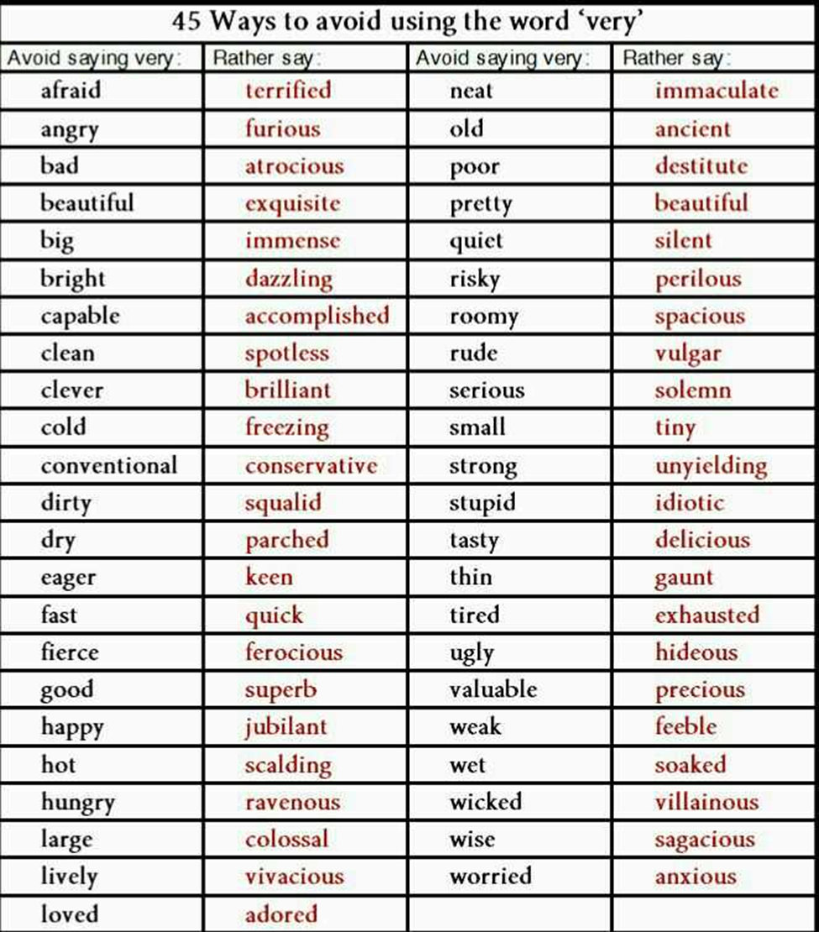
Intensifiers that Don't Intensify

Slide 45
Avoiding Expletive Constructions
There are twenty-five students who have already expressed a desire to attend the program next summer. It is they and their parents who stand to gain the most from the government grant.
Twenty-five students have already expressed a desire to attend the program next summer. They and their parents stand to gain the most from the government grant.

Slide 46
Be economical with words
This is to inform you that I am interested in applying for the position of Junior Engineer. (17 words)
I am interested in applying for the post of Junior Engineer. (11 words)

Slide 47
Be economical with words
2. I am truly the best choice among all the candidates because I qualified Bachelor of Technology in Mechanical Engineering with a really excellent CGP of 7.8. Also, besides the core B. Tech course in Mechanical Engineering, I quite a bit was motivated to pursue several technical courses to enhance my skills and knowledge.
I’m the ideal candidate for the Junior Engineer role, holding a B. Tech. in Mechanical Engineering with a strong CGPA of 7.8. I've also pursued additional technical courses to enhance my skills and knowledge."
With a B. Tech. in Mechanical Engineering (CGPA 7.8) and additional technical training, I’m confident in my qualifications for the Junior Engineer role.

Slide 48
Be Concrete
Concrete words
Abstract words
Specific
Limited interpretation
Forceful
Direct and to the point
General
Ambiguous
Vague
Digress from the point

Slide 49
Be Concrete
Concrete words
Abstract words
A 20% rise in wages is expected.
2-Day Workshop on communication skills will be organised in the next semester.
100 sq mt size office on the second floor of Main Building is required.
Quite a few students opt for the elective courses.
There is a slim chance for him to get a job.
Sakshi did fairly well in her last semester exam.
He was quite a bit reluctant to share the details of his meeting with the boss.

Slide 50
Be Concrete
A. The company suffered a tremendous loss in the first quarter of the last year.
Revised: In the 2022 April quarter, a 20% loss in profits is calculated.
B. The smell of the coffee is good.
Revised: The aroma of the coffee is refreshing.

Slide 51
Be Considerate
Avoid negative replies
I cannot help you with the assignment.
Revised:
I appreciate you reaching out to me for assistance with the assignment. Unfortunately, I’m unable to provide the support you need at this time. However, I’d be happy to help you explore alternative resources or provide guidance on where to find the information.
Thank you for considering me for help with your assignment. I regret that I’m not in a position to assist you with this task. Please let me know if there’s anything else I can help with in the future

Slide 52
Be Considerate
Avoid negative replies
2. I cannot talk with you right now.
Revised:
I’m busy at the moment, can we catch up later?
I’m tied up right now, let’s talk another time.
Can I call/text you back later? I’m in the middle of something.

Slide 53
Be Considerate
Construct Questions to know others’ opinions
We should redesign the company logo! Shouldn’t we redesign the company logo?
2. We must hire a new advertising agency. Couldn’t we hire a new advertising agency? Wouldn’t it be better to hire a new advertising agency?

Slide 54
Be Considerate
Construct Questions to know others’ opinions
What do you think about...?
How do you feel about...?
What are your thoughts on...?
Is there anything else you’d like to add?

Slide 55
Use Acronyms and Abbreviations sparingly
Introduce acronyms the first time you use them by defining them in full, parenthetically. Example: I pursued engineering from U.I.E.T., or I pursued Computer Science Engineering from the University Institute of Engineering and Technology.
Do not use acronyms related to the technical field when communicating with individuals from different fields. Example: A meaningful sentence follows SVO order.
Restrict the number of acronyms in individual sentences.
Define the acronyms in a separate list if several potentially confusing acronyms are being used.

Slide 56
Using Abbreviations Effectively
Do not abbreviate words at the beginning of the sentence.
Do not abbreviate proper nouns.
The rule varies as a matter of style (MLA/ APA). Abbreviations that include the last letter of the word being shortened do not take a period. For example, Dr ( Doctor), Mr (Mister) but exceptions to this rule is Prof.( Professor) and Col. (column).
Do not use phonic abbreviations like ‘u’ for ‘You’.

Slide 57
Business Tone
1. Use “ You Approach” judiciously
2. Learn the judicious use of voice in a sentence, whether active or passive, to get the desired response.
Use gender-neutral language
Be Confident

Slide 58
The Judicious use of “ You”
1. We will send your order soon.
Revised: You will receive your order by tomorrow.
2. The project report was submitted on time by you.
Revised: You submitted the project report on time.
3. We will respond to you immediately.
Revised: You will get a response immediately.

Slide 59
Avoid the use of the “You” pronoun in Negative situations
1. You have failed to acquire the sales target of the second quarter.
Revised: The sales target has not been met of the second quarter.
2. You have not mentioned the important details of the job profile.
Revised: The important details of the job profile have not been mentioned.
3. You have delayed my order.
My order has been delayed, or I have yet to receive my order.

Slide 60
Avoid the use of the “You” pronoun in Negative situations
You have broken my computer! My computer has been broken!
You said you were going to sign the deal today. It was understood that you were going to sign the deal today.
You agreed to lower your fees. It was agreed that you were going to lower your fees.

Slide 61
Use of active voice and passive voice
1. Our implementation of the new procedure is required by the board of directors.
The board of directors requires us to implement this new procedure.
2. My first visit to your organization will always be remembered.
I will always remember my first visit to your organization.
3. From these findings, it is indicated that none of you has notified me.
These findings indicate that none of you has yet notified me.
4. A weekly meeting is recommended as a way to reduce problems generated within the Training Division.
We recommend a weekly meeting as a way to reduce problems generated within the Training Division.

Slide 62
Use Gender Neutral language
1. Salutation:
Dear Sir/mam
2. Job Title:
Chairman/ Chairwoman/ Chairperson
3. Phrases that imply gender:
Executives and their spouses
4. Masculine pronouns:
Each student must provide his/her lab jacket.

Slide 63
Points to remember
1. Try to remain as professional and conversational as possible.
2. Active voice makes one’s writing direct, forceful and accurate whereas passive voice makes it lengthy and vague.
3. To make the writing livelier and direct, avoid passive voice.
4. Avoid using text message language such as ASAP, LOL, etc.
5. Avoid the use of contractions such as don’t, ma’am, won’t etc.

Slide 64
Which is a persuasive statement?
1.
a. You must agree that I am qualified for the position.
b. My qualifications make me suitable for this job.
c. My qualifications in the field of electrical engineering meet your job requirements.
2.
a. I think I can handle the position of responsibility.
b. In the past, I have held the position of responsibility so I believe I would be able to.
c. In my college’s cultural fest, I was the cultural secretary.

Slide 65
Exercises
Considering the aspects of style and tone in business messages, rewrite the following sentences:
You cannot explain the situation well.
I cannot help you.
You have mishandled the product so we cannot do anything about it.
We cannot hire you.
6. The pizza Radha burnt
7. To the Mughlai restaurant we had to go for the dinner.
8. You have the report?
9. The presentation was good.

Slide 66
Answers
1. You cannot explain the situation well. ( The second person “you” sounds harsh and rude at the beginning of a sentence)
1. The situation is not explained well. (changed the emphasis from the subject to the action: passive voice)
2. I cannot help you. (The personal pronoun sounds blunt and direct without a buffer statement)
2. I am afraid, I don’t know about this. Or, As I have to complete this assignment, if it’s okay with you, I can help you after a while. (be indirect)
3. You have mishandled the product so we cannot do anything about it. (The second person “you” sounds blaming)
3. According to the company’s policy, we don’t replace damaged goods. (be polite in negative situations)
4. We cannot hire you. (it sounds rude to be direct in negative messages)
4. We have recruited, but we have kept your resume for consideration in future. (be indirect)
5. My motivation helped you to get a job. (The possessive pronoun sounds arrogant and insincere)
5. You have been motivated to achieve your goal since the beginning of your college years. (The second person “you” sounds sincere and celebratory)

Slide 67
Answers
6. The pizza Radha burnt (follow subject verb object word order)
6. Radha burnt the pizza.
7. The girl was walking the dog on the phone. (The order of words is incorrect )
7. The girl on the phone was walking the dog.
8. To the Mughlai restaurant, we had to go for the dinner. (The order of words is incorrect)
8. We had to go to the Mughlai restaurant for the dinner.
9. You have the report? (incorrect use of punctuation)
9. Do you have the report? (formed an interrogative sentence)
10. The presentation was good. (description is vague)
10. The presentation was descriptive/engaging. (description is specific)

